Slide 1
Rail Transport
Basics

Slide 2

How do I use this learning material?
PowerPoint slides
The following PowerPoint presentation contains basic and in-depth information on rail transport. The notes give a quick overview of each slide and the sources used.
Reader
Additionally, a reader doubling as a script and containing more details is provided.
Links
The sources used are listed in the learning packages in a link collection.
Videos
Furthermore, there are also videos in the relevant learning packages.

Slide 3
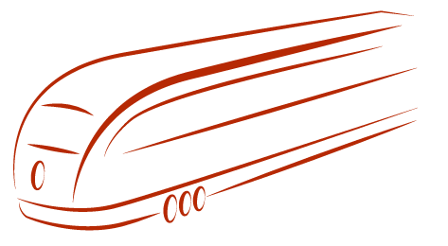

Introduction
What do you associate with rail transport?

Slide 4
Agenda
Characteristics
Freight transport by rail
Forms of production in rail-based freight transport

Slide 5
Characteristics of Rail Transport
strengths
high mass transport efficiency
high safety and reliability
low unit costs
suitability for automation
weaknesses
high share of fixed costs
terminal to terminal transport
relatively low flexibility
Notes:
Strengths:
High mass efficiency:
This means that a relatively high volume of people or goods can be transported per transport transaction.
High safety and reliability:
Rail is considered a safe mode of transport as serious accidents are rare.
Low unit costs:
Low costs per transported unit.
Suitability for automation:
There are already a number of driverless rail vehicles (e.g. the Dubai Metro).
Weaknesses:
High proportion of fixed costs:
Fixed costs remain constant, regardless of how much is produced. Variable costs increase with production. The higher the share of fixed costs, the more a company is forced to increase its capacity utilisation.
Terminal to terminal transport:
If there is no direct connection between the customer and the railways, other modes of transport (essentially road transport) must be used in the pre- and post-carriage.
Relatively low flexibility:
Destinations and times are very often linked to a timetable, and it is not possible to change routes. Furthermore, due to the high cost and time involved in building and maintaining the infrastructure, it is only possible to adapt slowly to changing economic conditions.
Source: Cf. Kummer (2010) p. 89 f.

Slide 6


The Rail Sector and its Competitors ...
higher degree of area coverage
greater flexibility
door-to-door services
higher risk of accidents
limited loading capacity for heavy and large-volume objects
high mass output
terminal-to-terminal traffic
longer transport time
higher packaging requirements
Notes:
In comparison to road transport, rail has a higher mass efficiency (thus a corresponding suitability for heavy or voluminous transport objects) not least due to its larger dimensions, as well as higher requirements in connection with safety agendas. Road transport, on the other hand, scores with its door-to-door service for its customers. Like inland navigation, rail transport can only offer terminal-to-terminal transport. Only very few customers have a direct rail or waterway connection. This in turn necessitates the use of road traffic to overcome the first and last mile and means less flexibility for the customer and the operator of the respective means of transport. One of the topics often discussed in connection with inland navigation is transport time. A large number of companies do not generally rely on inland navigation due to its longer running or transport time and its higher packaging requirements. The high demands placed on packaging in particular are of great importance for the protection of the transported object due to existing weather conditions.
Source: Cf. Kummer (2010) pp. 86f; Cf. Kummer (2010) pp. 109.

Slide 7
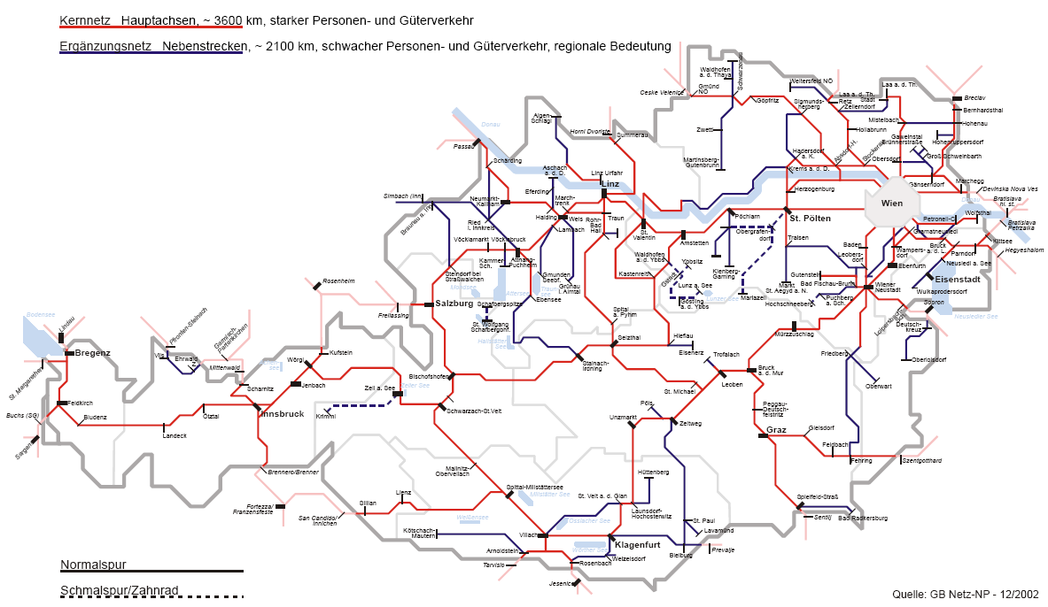
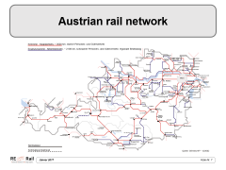
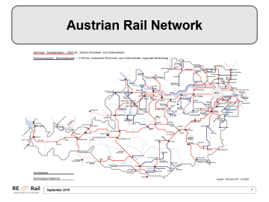
Austrian Rail Network
Notes:
As of 31.12.2015, the rail network operated by ÖBB-Infrastruktur AG comprises a total of 4846 line kilometres, of which 3517 km are spanned by overhead electrical lines, and 1095 traffic stations. The route network also includes 290 electronic signal boxes, 246 tunnels and galleries, approx. 6327 bridges and viaducts and approx. 3398 railway crossings.
Source: Cf. ÖBB Infra (2017), online.
All important information about the railway infrastructure in Austria:
http://www.oebb.at/infrastruktur/de/2_0_The_Company/Data_and_Facts/_DMS_Files/_Figures_Data_Facts.jsp

Slide 8
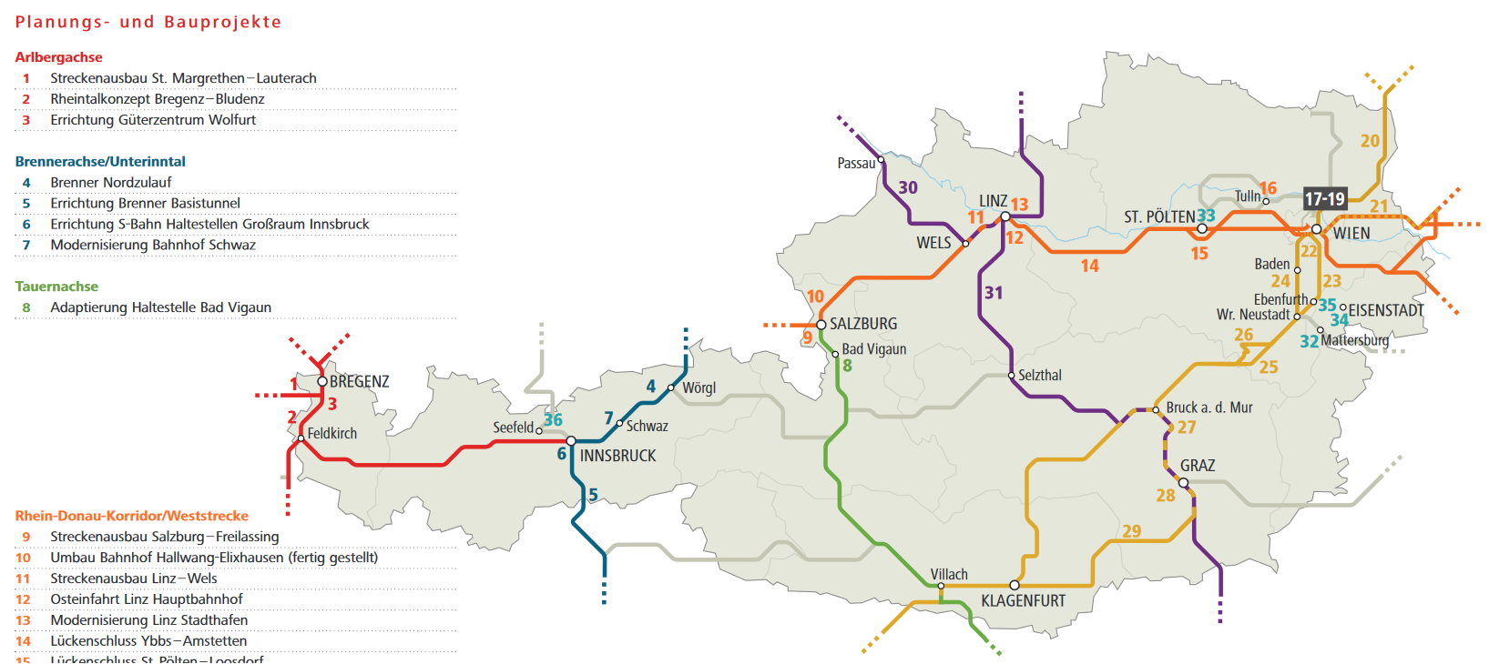
Rail Construction Projects in Austria
Notes:
Comprehensive information on railway infrastructure in Austria:
http://www.oebb.at/infrastruktur/de/2_0_The_Company/Data_and_Facts/_DMS_Files/_Figures_Data_Facts.jsp

Slide 9
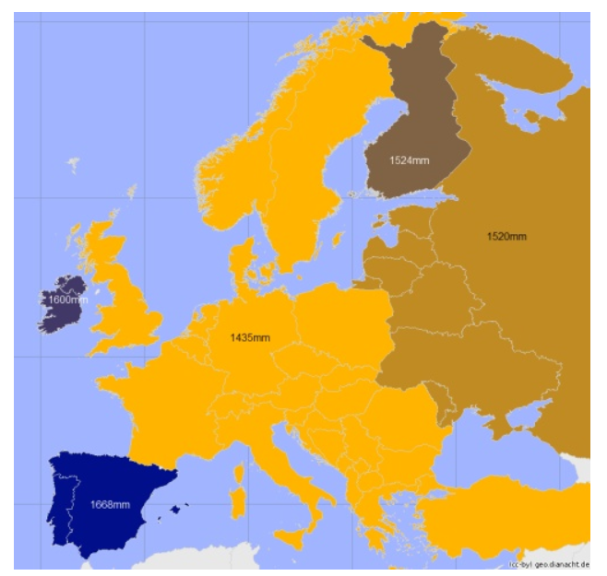
Track Widths
Main Track Widths in Individual States
Notes:
Track gauge is defined as the distance between the inner edges of the rails. Since the invention of the railway, the so-called standard gauge (1435 millimetres) has spread from England and established itself in most European countries and countries all over the world. It was defined as the "European standard gauge".
However, there are also deviations from the standard gauge:
Narrow gauge: this is narrower and occurs in private, museum or factory railways and does not play a major role.
Broad gauge: this is wider and occurs nationwide in different widths in individual countries, for example in Spain, Portugal, Finland and the states of the former Soviet Union.
The deviations from the normal gauge had different reasons: on the one hand, for military strategic reasons, a different gauge than in the neighbouring countries was deliberately chosen in order to make it more difficult for hostile supplies to be transported in the event of a military conflict. On the other hand, track gauges were based on different national measurement systems.
Source: Forschungsinformationssystem (2016a), online.

Slide 10
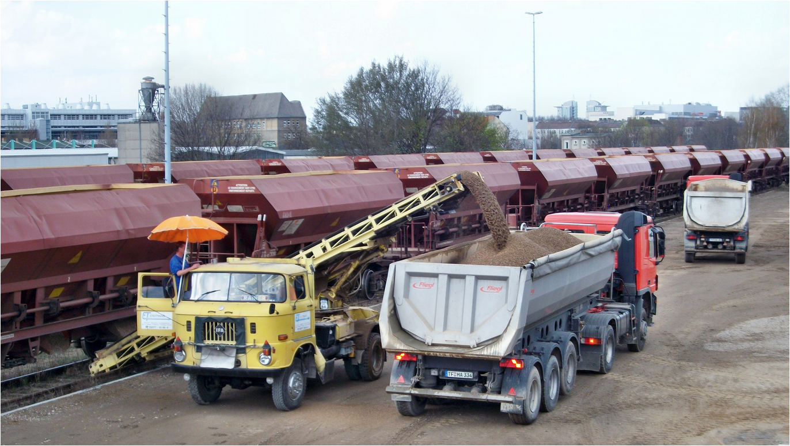
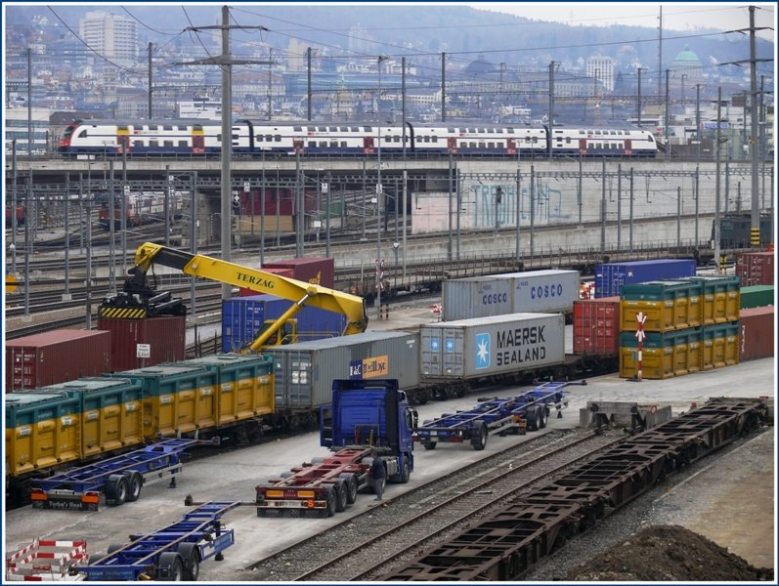
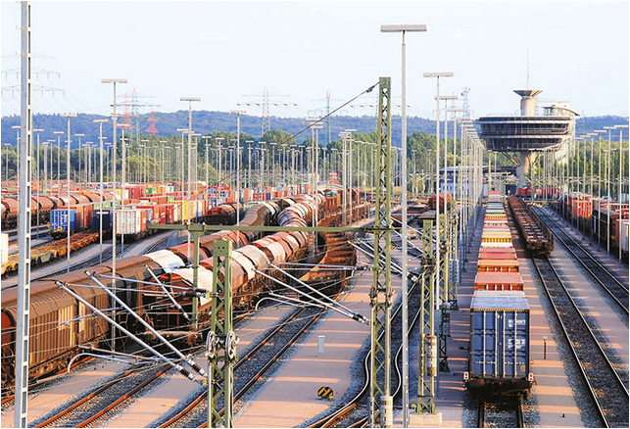
Freight Stations
Notes:
Freight stations are railway facilities where
goods are received or distributed
goods are transhipped to rail
goods are transhipped from rail
freight wagons are handed over to siding tracks
freight wagons are shunted
Cf. Kummer (2010), p. 149
Images: Bahnbilder (2017), online; Vepas (2017), online; Port of Hamburg (2016), online.

Slide 11
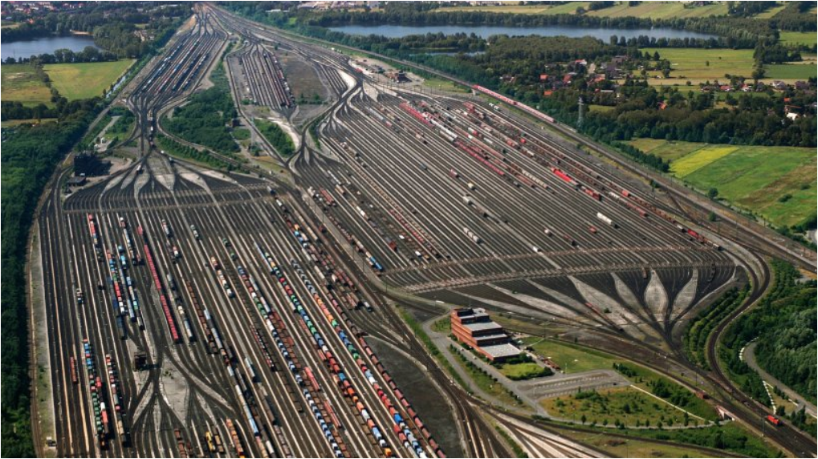
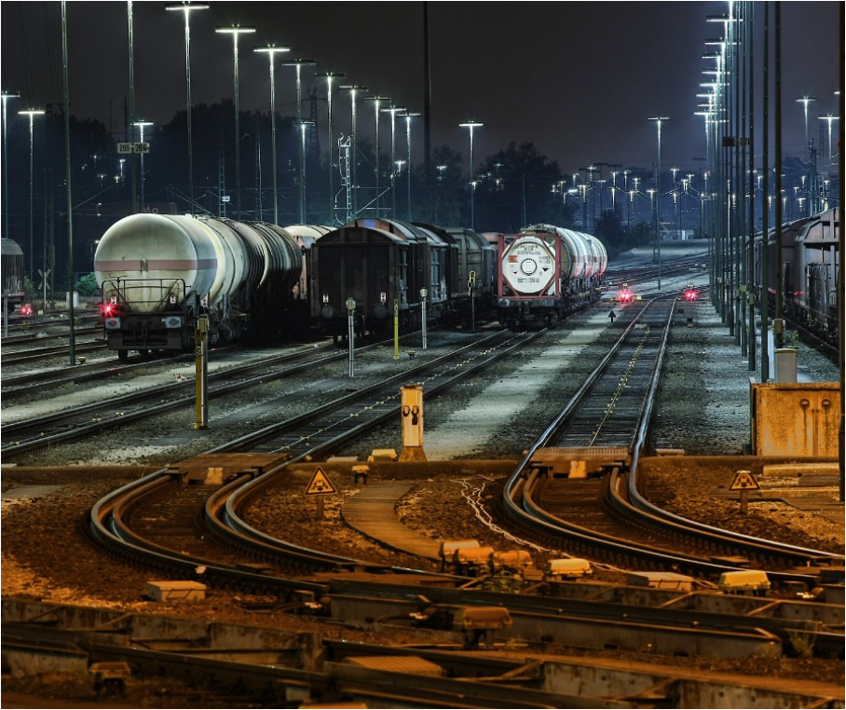
Marshalling Yards
Example Hamburg-Maschen:
the largest marshalling yard in Europe and the second largest in the world
Marshalling yards (shunting yards) are stations where individual wagons are assembled for transport or separated again.
Notes:
Images: Abendblatt.de (2017), online; Hamburg-Maschen (2017), online.

Slide 12
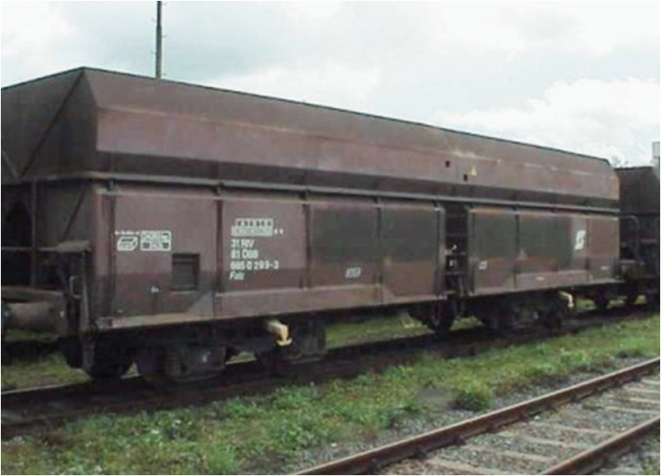
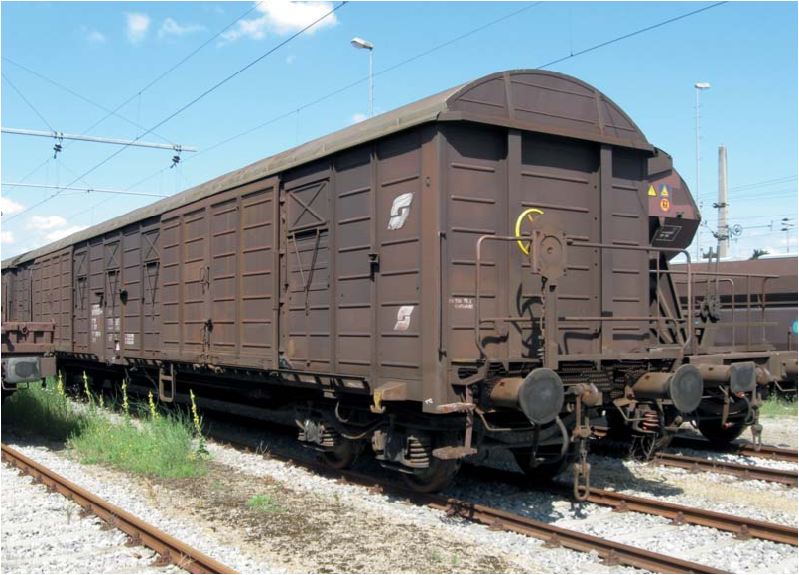
Wagon Types I
Open wagon
Covered wagon
Notes:
An open freight car is an all-round closed rail cargo car without a roof. This is particularly suitable for weather-independent transport goods such as bulk goods (e.g. coal, stones).
A covered freight wagon is a railway freight wagon whose loading space is formed by side walls and a roof. These wagons are preferably used for the transport of goods which are to be protected against weather influences, loss or theft.
Images: Rail Cargo Wagon (2017a), online; Rail Cargo Wagon (2017b), online

Slide 13
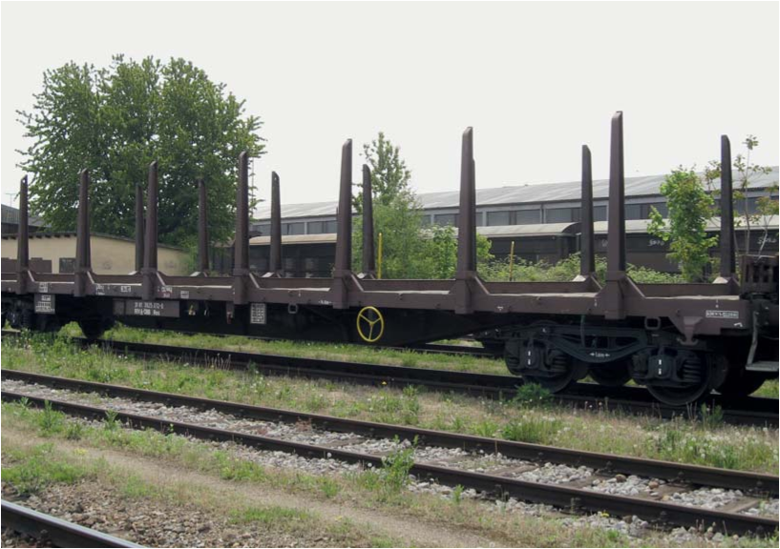
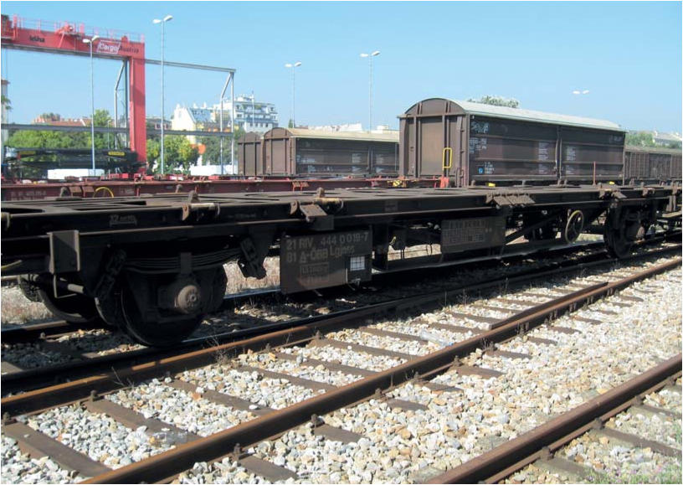
Wagon Types II
Flat wagons
Container car
Notes:
Flat wagons are particularly suitable for transporting wood, steel or machinery. These are cargo wagons with a flat superstructure and no or at most low superstructures that are open at the top.
Container wagons are flat wagons specially equipped with fastening devices for transporting containers.
Images: Rail Cargo Wagon (2017c), online; Rail Cargo Wagon (2017d), online.

Slide 14
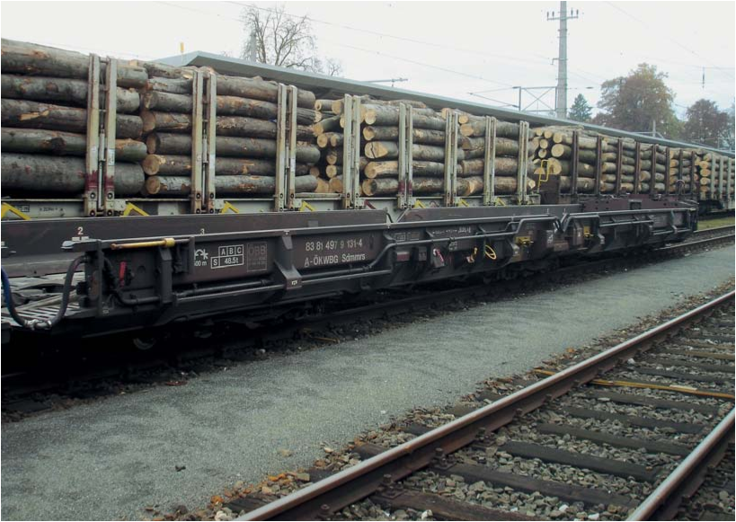
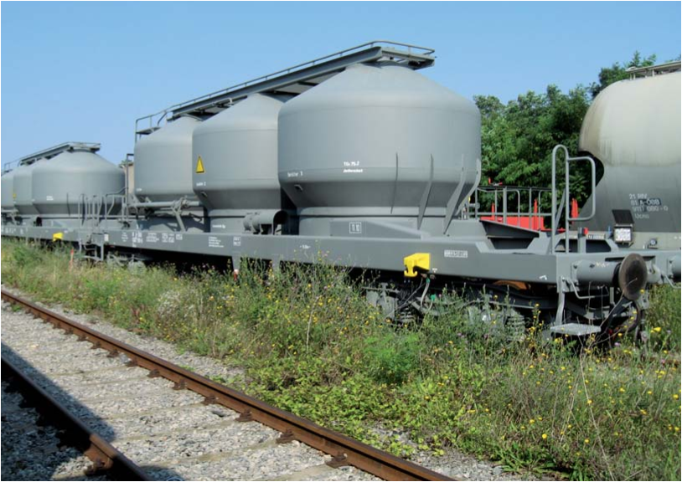
Wagon Types III
low-floor freight cars
tank truck
Notes:
A tank wagon is a special rail cargo wagon with one or more closed containers (tanks) used for the transport of gaseous or liquid goods. Most of these are bought or rented by the shipping industry itself (chemicals and mineral oil).
Cf. Becker (2014), p. 32
Images: Rail Cargo Wagon (2017e), online; Rail Cargo Wagon (2017f), online;

Slide 15
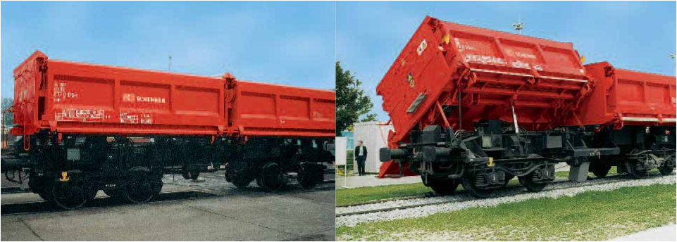
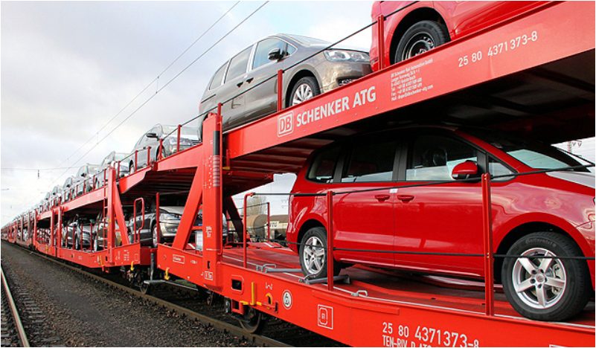
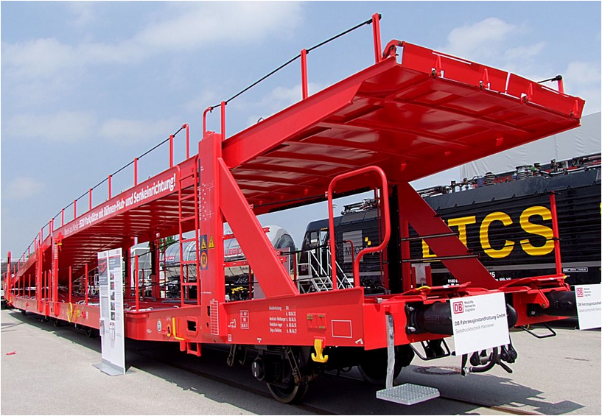
Wagon Types IV
bulk freight tipping wagon
car transport wagon
Notes:
Images: DB Schenker (2009), p.38; Bahnbilder.de (2017b), online; Frauinfahrt.de (2017), online.

Slide 16
Agenda
Characteristics
Freight transport by rail
Forms of production in rail-based freight transport

Slide 17
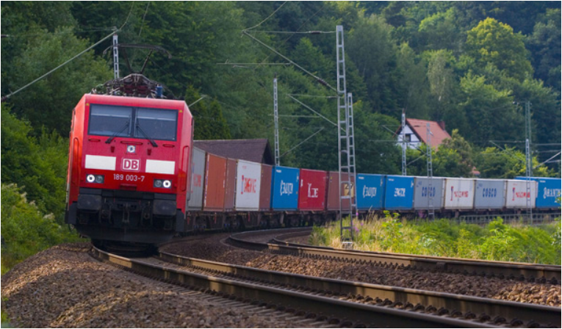
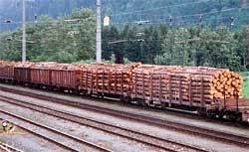
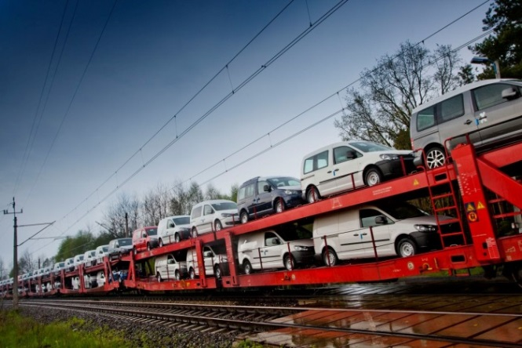
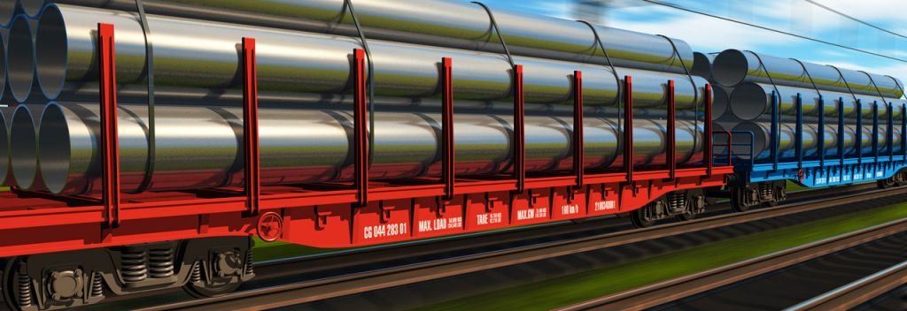
Which goods are carried by rail?
Notes:
Images: Waldwissen.net (2016) online; Logistik-heute.de (2015) online; Verkehrsrundschau.de (2016), online; ZTE (2017), online.

Slide 18
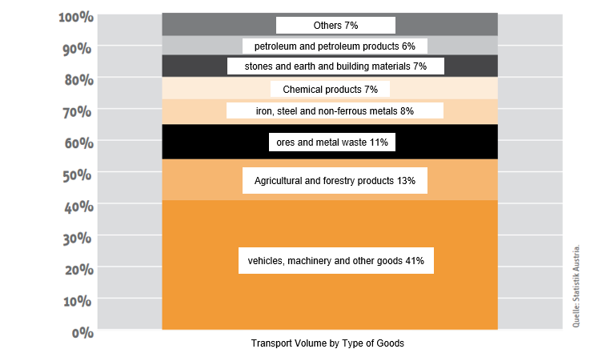
Transport Volume by Type of Goods
Notes:
Transport volume of domestic railway undertakings by type of goods 2012
The category "vehicles, machinery and other goods" is the most important type of goods on rail and represents 41 percent of the goods transported by domestic railway companies. However, this category also includes goods which cannot be otherwise attributed or of which the container contents are not known.
Agricultural and forestry products come second with 13 percent of the traffic volume. The share of "wood and paper products as well as data carriers" contained therein accounts for around 5.8 percent of the transport volume. This is followed by "ores and metal waste" (11 percent) and "iron, steel and non-ferrous metals" with 8 percent. A total of twelve percent of the tonnage is declared as dangerous goods, predominantly "flammable liquid substances".
Source: Economica (2013), p. 18f.

Slide 19
Agenda
Characteristics
Freight transport by rail
Forms of production in rail-based freight transport

Slide 20
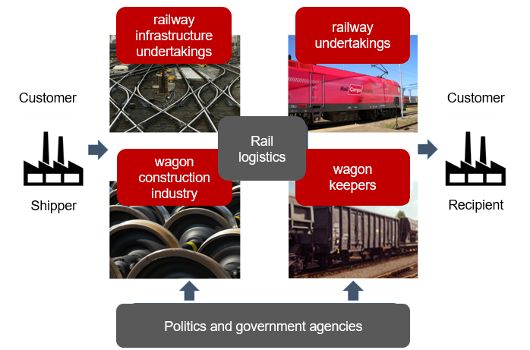
Rail Cargo Operators
Notes:
The transport of goods by rail is carried out by railway undertakings (RUs). They are public RUs if they are operated on a commercial or business basis and anyone can use them for the carriage of passengers or goods. All others are non-public RUs.
The classic resources of a RU include:
locomotives (diesel or electric)
freight wagons and
staff (e.g. locomotive driver, shunter)
Source: Cf. Becker (2014), p. 45f.
The railway network is maintained and operated by a railway infrastructure undertaking. There are public companies, which must grant access to their railway infrastructure. All other companies, e.g. factory and industrial infrastructure, connecting railway lines, are non-public.
The resources of a railway infrastructure undertaking include track systems, signalling equipment, level crossings, signal boxes, railway stations and terminals. Cf. Becker (2014), p. 64
One of the most important resources in rail cargo transport is rail cargo wagons/cars, whose keepers or owners can be:
railway undertakings (RUs)
rental companies
haulage companies
shippers from industry and trade
Source: Cf. Becker (2014), p. 77
Customers, i.e. demanders of rail cargo services, are also called shippers. The shipping industry consists of a large number of partly very different companies from different sectors. The requirements shippers place on providers of rail cargo transport services are correspondingly diverse:
Competitive transport prices
Optimal and efficient railway business process
One contract partner for the entire route
Personal and individual support and information
Reliable and predictable transport times
Responsible Care (transport safety)
environmental compatibility
Source: Cf. Becker (2014), p. 67f.
Illustration: according to: Becker (2014), p. 45

Slide 21
Forms of Production
block train service
wagon group traffic
single wagon traffic
combined transport
Notes:
In rail cargo transport, various products (services) are offered for the transport of consignments. This form of production or type of service provision is decisive for the efficiency and economy of rail cargo transport.
A distinction can be made between conventional traffic (block trains, wagon groups and single wagons) and combined traffic.
See Becker (2014), p. 37 ff.; Kummer (2010), p. 94.

Slide 22
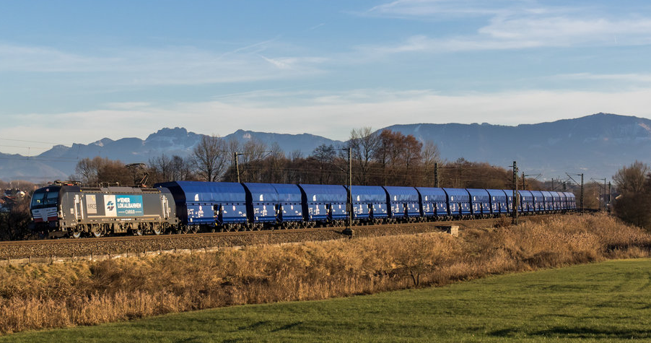
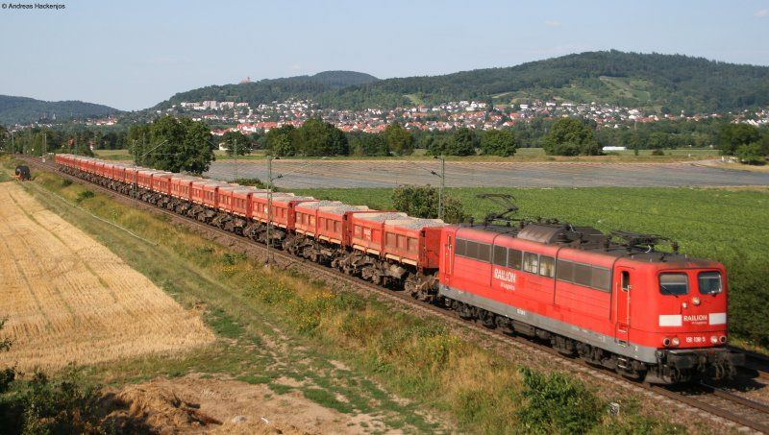
Block Train
A block train is a freight train that runs as a whole train from starting to destination station.
This makes block train transport faster and cheaper than single wagon transport.
Block trains are suitable when large quantities of one load type are transported.
Notes:
References for slide: Cf. Kummer (2010), p. 94; Bahnbilder(2016a), online; Bahnbilder(2016b), online.
It is essential for block trains that no further shunting operations (e.g. adding wagons to the train or removing wagons from the train) take place during transport. Block train services are frequently used for transporting bulk goods (e.g. coal, ore, mineral oil) but also in the automotive industry. Further advantages are short transport times (above all due to the relatively low shunting effort), relatively low organisational costs for train dispatching and planning departure and arrival times, and safety during transport (also due to the low shunting effort). In summary, it can be said that large quantities of goods can be transported safely over long distances with relatively low energy consumption.
Cf. Clausen / Geiger (2013), p. 169 ff.
Block train transports by rail have cost advantages over lorries over almost all distances.
This applies not only to conventional freight transport, but also to unaccompanied combined transport and the rolling road or rolling highway. Road transport has a competitive advantage over single wagon transports on rail in the low distance ranges. In single wagon traffic of conventional freight traffic (for domestic journeys), the truck causes lower costs than rail in distance ranges up to 150 km. From distances of 150 km the cost advantage of the truck shrinks and disappears for distances from 250 km.
Economica (2013), p. 6

Slide 23
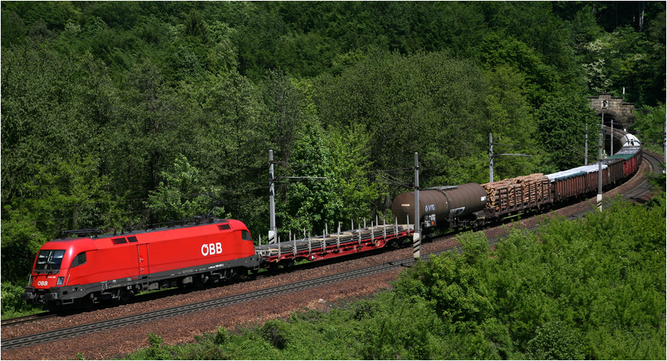
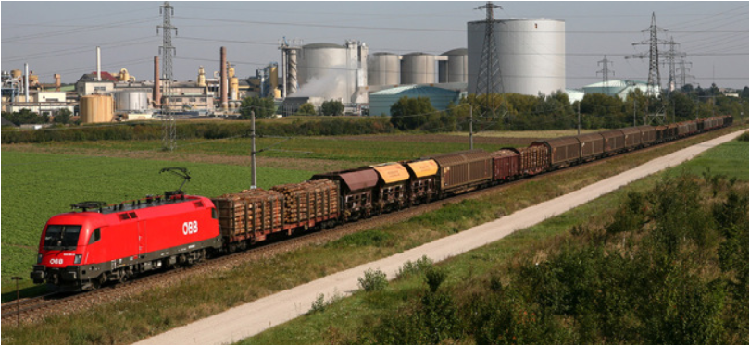
Single Wagon Traffic
Wagon Group Traffic
If there is not a sufficient volume of consignments, individual wagons or groups of wagons can also be transported on the rail network.
Individual wagons from different consignors are assembled into new freight trains in so-called train formation facilities.
Notes:
Cf. Clausen / Geiger (2013), p. 169 ff.
This type(s) of production is very similar to general cargo road haulage. By bundling the individual wagons, a better utilisation of the trains and thus a reduction in transport costs can be achieved. On the other hand, however, there are higher costs due to the provision of train formation facilities, shunting facilities and shunting staff. Due to the increased shunting effort, there are significantly longer transport and waiting times in the train formation facilities compared to block train traffic.
Cf. Clausen / Geiger (2013), p. 170
Images: Rail Cargo (2017), online; IHO (2017), online.

Slide 24
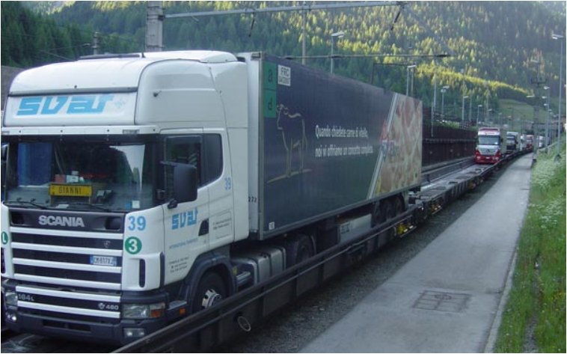
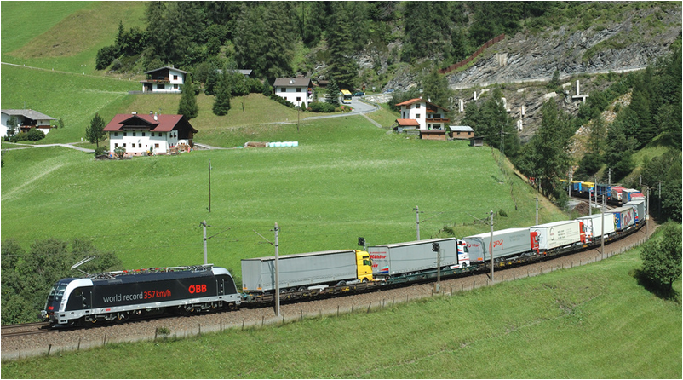
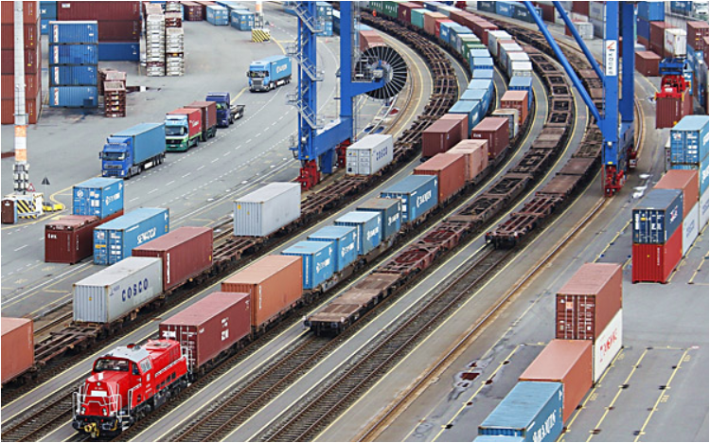
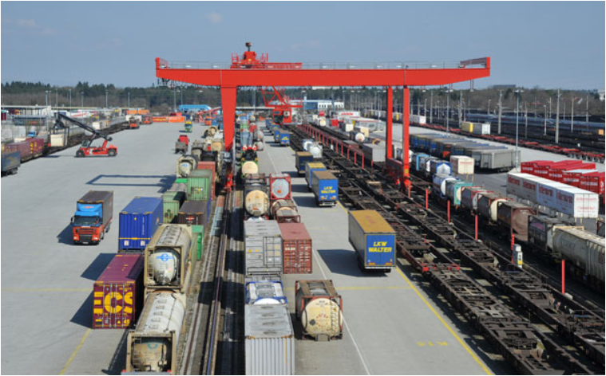
Combined Transport
Notes:
Combined transport is characterised by transport chains in which standardised loading units, such as containers, swap bodies, lorries or their trailers, are transported successively on different modes of transport. When changing modes of transport in terminals, only the loading units are handled, i.e. the goods remain in the same transport container during the entire transport.
The loading units (e.g. containers, swap bodies) are usually transported individually between the place of dispatch and the point of transshipment (pre-carriage) or point of transshipment and point of receipt (post-carriage). The main leg is the distance between the transshipment points (e.g. transshipment terminal).
Another characteristic of combined transport is that the main leg is covered by an environmentally friendly means of transport, e.g. by rail, but also by inland waterway or sea, while pre- and post-carriage by road is kept as short as possible.
See Kummer (2010), p. 57; Becker (2014), p. 39f; Forschungsinformationssystem (2016b), online.
Image sources: Rail Cargo (2017), online; Verkehrsrundschau (2013), online; Verkehrsrundschau.de (2014), online.
Verkehrsrundschau.de (2015), online.

Slide 25
References I
Abendblatt.de (2017): http://www.abendblatt.de/hamburg/harburg/article114456407/Endlich-Laermschutz-am-Rangierbahnhof.html (3.2.2017)
Bahnbilder (2016a): http://www.bahnbilder.de/bild/Deutschland~Strecken~KBS+951/983912/193-606-der-wlc-faehrt-mit.html (22.12.2016)
Bahnbilder (2016b): http://www.bahnbilder.de/bild/deutschland~e-loks~br-151/212065/151-138-5-mit-einem-falny-ganzzug.html (16.11.2016)
Bahnbilder (2017a): http://www.bahnbilder.de/bild/Schweiz~Stadtverkehr~S-Bahn+Zurich/278322/waehrend-im-gueterbahnhof-container-verladen-werden.html (3.2.2017)
Bahnbilder (2017b): http://www.bahnbilder.de/bild/deutschland~gueterwagen~4-gattung-l-flachwagen-mit-einzelradsaetzen-in-sonderbauart/511443/autotransportwagen-laaeks-db-schenker-atganlaesslich-der-transport-logistic2011.html (3.2.2017)
Becker, K. G. (Hrsg., 2014): Handbuch Schienengüterverkehr, Hamburg: DVV Media Group Eurorailpress
Clausen, U, / Geiger, Ch. (2013, Hrsg.); Verkehrs- und Transportlogistik, 2. Auflage, Berlin-Heidelberg: Springer Verlag
DB Schenker (2009): Unsere Güterwagen, in: https://www.dbschenker.at/file/log-at-de/10724932/SK_AAwVFo3PHNlLizZxUy_Gv8uA/10785774/data/gueterwagenkatalog.pdf (3.2.2017)
Economica Institut für Wirtschaftsforschung (Hrsg., 2013): Schienengüterverkehr: Markt- und Wettbewerbssituation, Wien, in: http://www.esce.at/eco3/wp-content/uploads/2016/04/2013-Schieneng%C3%BCterverkehr-Markt-und-Wettbewerbssituation-Folder.pdf
Forschungsinformationssystem (2016a): in: https://www.forschungsinformationssystem.de/servlet/is/325077/ (21.12.2016)
Forschungsinformationssystem (2016b): in: http://www.forschungsinformationssystem.de/servlet/is/306087/ (21.12.2016)
Frauinfahrt.de (2017): http://www.frauinfahrt.de/db-autozug-am-stau-vorbei/ (3.2.2017)
Gronalt, M. / Höfler, L. / Humpl, D. / Käfer, A. / Peherstorfer, H. / Posset, M. / Pripfl, H. / Starkl, F. (2010): Handbuch Intermodaler Verkehr, Wien: Bohmann
Hafen Hamburg (2016): https://www.hafen-hamburg.de/de/effizienter-und-umweltschonender-guetertransport-auf-der-schiene (22.12.2016)
IHO (2017): http://iho.hu/hir/uj-leanyvallalatot-hozott-letre-a-rail-cargo-austria-151002 (5.2.2017)
Hamburg-Maschen (2017): http://www.artwave.eu/Hamburg-Maschen/#img=Hamburg_Maschen_16.JPG (3.2.2017)
Kummer, S. (2010): Einführung in die Verkehrswirtschaft, 2. Auflage, Wien: Facultas
Logistik-heute.de (2015) : http://www.logistik-heute.de/Logistik-News-Logistik-Nachrichten/Markt-News/13078/GDL-legt-Schienengueterverkehr-unbefristet-lahm-Bahnstreik-Ausstand-mit-offe (16.11.2016)

Slide 26
References II
ÖBB Infra (2017): Schieneninfrastruktur, in: http://www.oebb.at/infrastruktur/de/_p_3_0_fuer_Kunden_Partner/3_2_Schienennutzung/3_3_Schieneninfrastruktur/index.jsp (30.1.2017)
Rail Cargo (2017): http://www.leitbetriebe.at/de/leitbetriebe/?mode=detail&id=3645e428-22f8-155f-5b47-4f9410a88b45#wrap-content (21.1.2017)
Rail Cargo Wagon (2017a): http://www.railcargowagon.at/de/Unsere_Fahrzeuge/_Factsheets_pdf/Fals_RCW.pdf (3.2.2017)
Rail Cargo Wagon (2017b): http://www.railcargowagon.at/de/Unsere_Fahrzeuge/_Factsheets_pdf/Gabs_RCW.pdf (3.2.2017)
Rail Cargo Wagon (2017c): http://www.railcargowagon.at/de/Unsere_Fahrzeuge/_Factsheets_pdf/Ros_RCW.pdf (3.2.2017)
Rail Cargo Wagon (2017d): http://www.railcargowagon.at/de/Unsere_Fahrzeuge/_Factsheets_pdf/Lgjnss_RCW.pdf (3.2.2017)
Rail Cargo Wagon (2017e): http://www.railcargowagon.at/de/Unsere_Fahrzeuge/_Factsheets_pdf/Sdmmrs_Web.pdf (3.2.2017)
Rail Cargo Wagon (2017f): http://www.railcargowagon.at/de/Unsere_Fahrzeuge/_Factsheets_pdf/Uacs_RCW.pdf (3.2.2017)
Railnetaustria (2016): http://www.railnetaustria.at/vip8/betrieb/de/ und http://www.oebb.at/vip8/bau/de/ (22.12.2016)
Verkehrsrundschau.de (2013): http://www.verkehrsrundschau.de/kombinierter-verkehr-sgkv-beraet-bmvbs-1194981.html (21.12.2016)
Verkehrsrundschau.de (2014): http://www.verkehrsrundschau.de/oesterreich-gegensaetzliche-nachfrage-nach-rollender-landstrasse-1364356.html (21.12.2016)
Verkehrsrundschau.de (2015): http://www.verkehrsrundschau.de/oesterreich-rail-cargo-group-organisiert-terminalbetrieb-neu-1705563.html (21.12.2016)
Verkehrsrundschau.de (2016): http://www.verkehrsrundschau.de/bahn-erhoeht-preise-deutlich-staerker-als-lkw-unternehmen-1259813.html (22.12.2016)
Waldwissen.net (2016): http://www.waldwissen.net/waldwirtschaft/holz/logistik/fva_bahntransport_28/index_DE (8.11.2016)
Vepas (2017): http://www.vepas-bahnservice.de/wp-content/uploads/Treptow_Umschlag_1.jpg (3.2.2017)
ZTE (2017): http://zte-schwertransporte.de/de/angebot/schienenguterverkehr/ (3.2.2017)

Slide 27

Additional Information
We hope our PowerPoint presentation meets your requirements!
You are welcome to adapt this presentation according to your wishes and requirements and to use it for your lessons/lectures.
We are happy to receive your questions or feedback at rerail@fh-vie.ac.at .
Further PowerPoint slides and teaching resources at
http://www.retrans.at/de/

